Slide 1
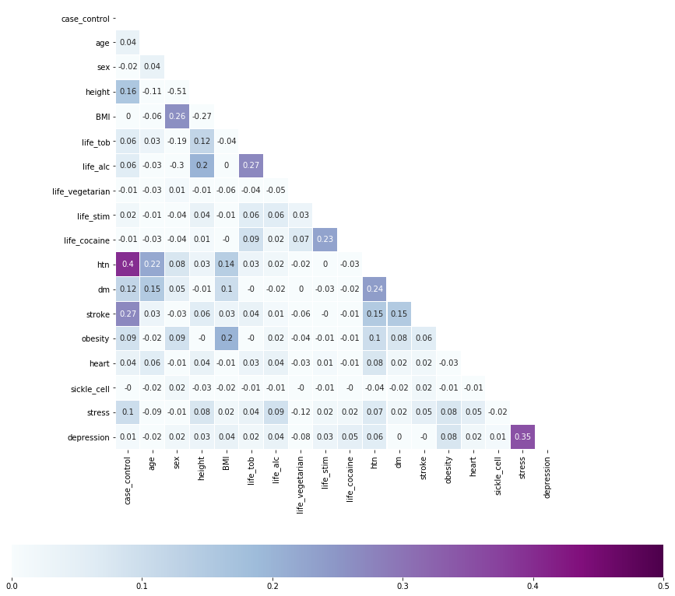
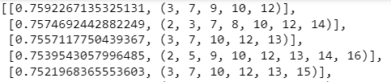
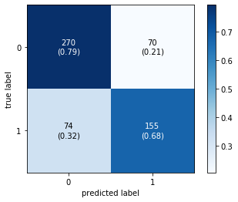
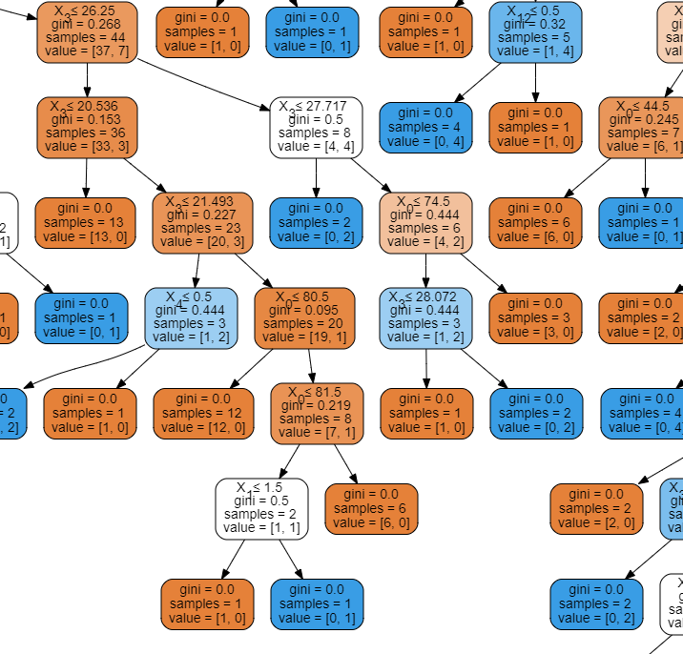
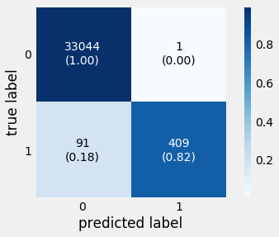
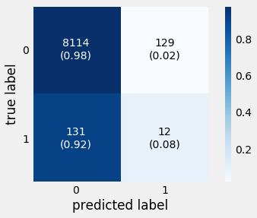
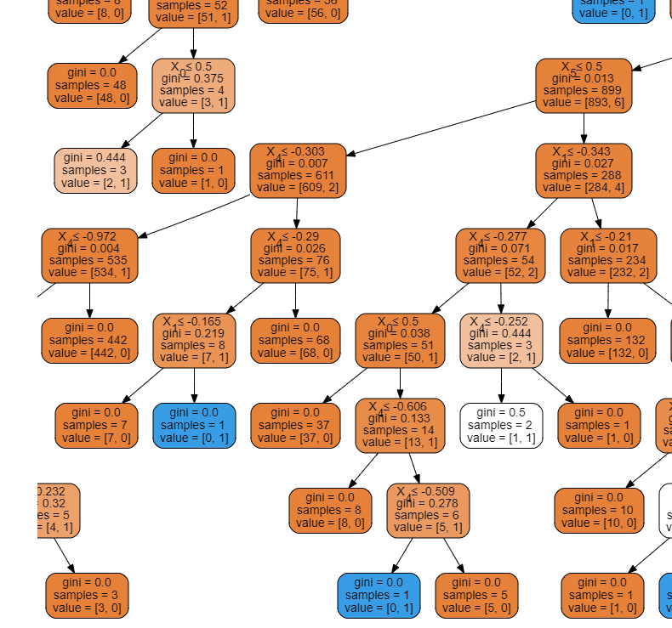
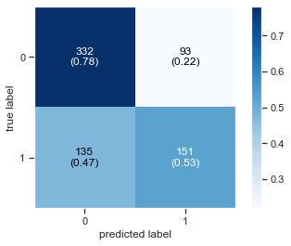
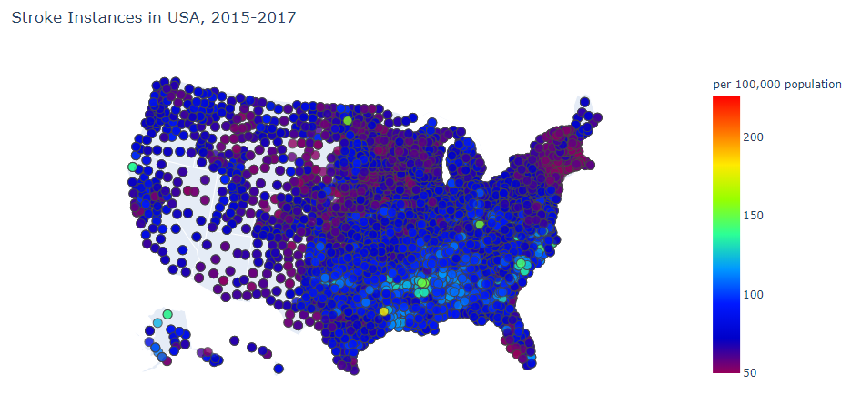
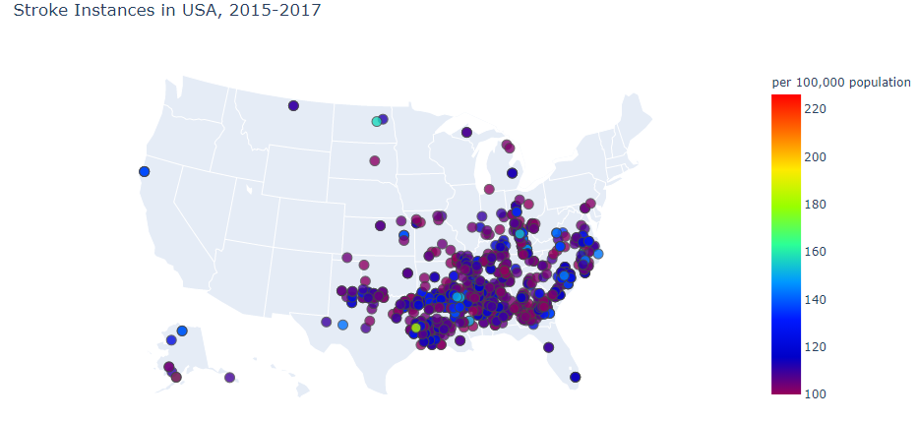
Prediction of Stroke in Sub-Saharan Africa/United States Group 16: Bruce Wen, Deirdre Edward, Isabelle Russo, Lynnette Jiang
Introduction
Aim
Background:
Discuss report that discusses stroke prediction
Which factors affect stroke rate?
How was SIREN data obtained?
What is novel about our project (because African dataset was never used before, and that a lot of people have tried predicting stroke for American population)
Others
Test Different Machine Learning Classification algorithms to predict stroke accurately
Select best algorithm through training/testing on SIREN dataset to predict stroke in Sub-Saharan Africa
Visualize publicly available stroke data in the United States
Compare trained algorithms between datasets from the United States and Sub-Saharan Africa
Methodology
Datasets Utilized
Data Cleaning Flow
Classification Methods Used
CDC Stroke Mortality Data:
Stroke Mortality among US adults above 35 years old, 2015-2017 => generate US stroke maps
Filter by County, Overall Stratification, and remove null values
Plot Geo-Scatters of Stroke Cases via plot.ly library
K Nearest Neighbors
Decision Trees (CART, Classification And Regression Trees)
Logistic Regression
Random Forest
Support Vector Machine
SIREN Stroke Data:
Stroke data and 16 predictor variables for 2800+ patients in Nigeria and Ghana
Evaluation of Algorithms
Accuracy Rate
Rate of True Positive and True Negative (Confusion Matrix)
Convert .sav to .csv format
?? What else did Deirdre do?
Decision Tree
Kaggle US Stroke Data:
Stroke data and 10 predictor variables for ~60,000 patients in US
Binarize categorical variables
Standardize continuous variables
Pearson Correlation Coefficients Table
Results
Machine Learning Algorithms on SIREN dataset
Top 5 Accuracy Rates among all Combinations of Variables
K Nearest Neighbors
CART Decision Tree on US Kaggle dataset
Confusion Matrix for selected variables (Highest TP, TN):
Sex, height, vegetarian, stimulant, cocaine, hypertension, past instance of stroke, heart disease
Training Dataset
Testing Dataset
US Stroke Maps, 2015-2017
Discussion and Conclusion
Future Work
References
Notes:
Stretch the margin to the ends

